Slide 1



Airline Sentiment Analysis
on Twitter
Presented By :
Nour Gaja
Molka Ouelhezi
Ons Guizani
01

Slide 2

Problem &
Objective
The Problem
Our Objective
Airlines receive thousands of tweets every day, and there is no scalable solution for processing them. This creates a significant backlog, as manual reviews are slow and prone to bias, ultimately resulting in critical patterns being overlooked. Valuable customer feedback is wasted, which could otherwise inform service improvements and enhance customer satisfaction.
We propose an end-to-end NLP pipeline that classifies every tweet as Negative, Neutral, or Positive. By utilizing supervised Logistic Regression and unsupervised K-Means clustering, we can efficiently analyze sentiment in real-time. This approach allows airlines to harness customer feedback proactively, driving improvements in service and addressing passenger complaints effectively.
02
twitter.com/airlines

Slide 3


Dataset Overview
Tweet Volume : 14,640 tweets collected from Kaggle dataset.
Airlines Covered : 6 major U.S. airlines covered: United, American, Southwest, Delta, US Airways, and Virgin America.
Sentiment Classes : 3 sentiment classes: Negative, Neutral, Positive.
Source : https://www.kaggle.com/datasets/zahranusratt/us-airline-twitter-sentiment-analysis-dataset
03

Slide 4
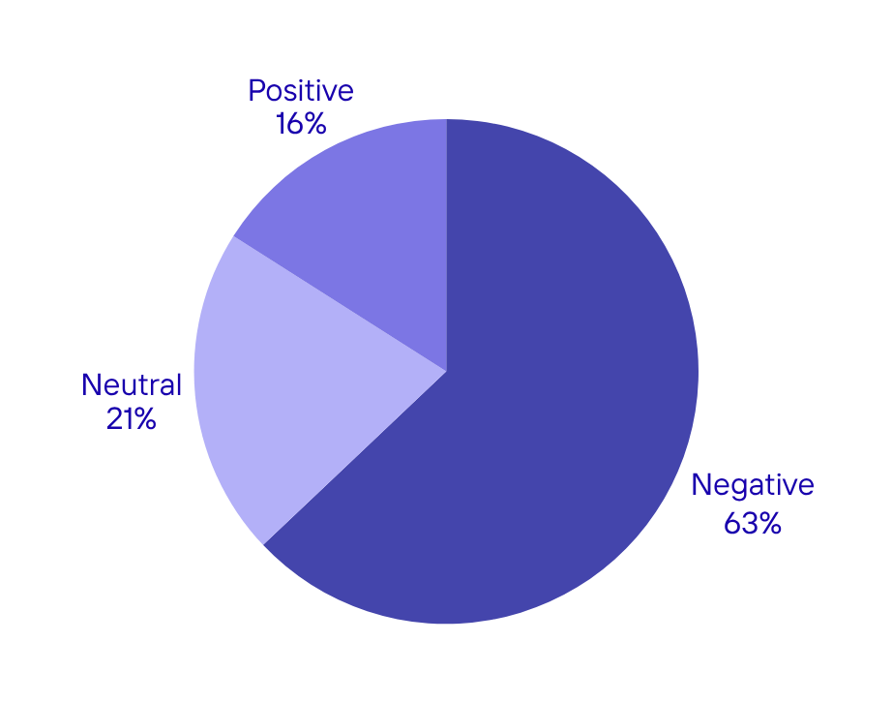
Sentiment
Distribution
Key Insight:
Negative sentiment dominates airline Twitter discourse, reflecting vocal dissatisfaction among passengers. This imbalance highlights that customers are more likely to voice complaints than praise on social media platforms, making sentiment analysis crucial for identifying service improvement opportunities.
04
twitter.com/airlines

Slide 5

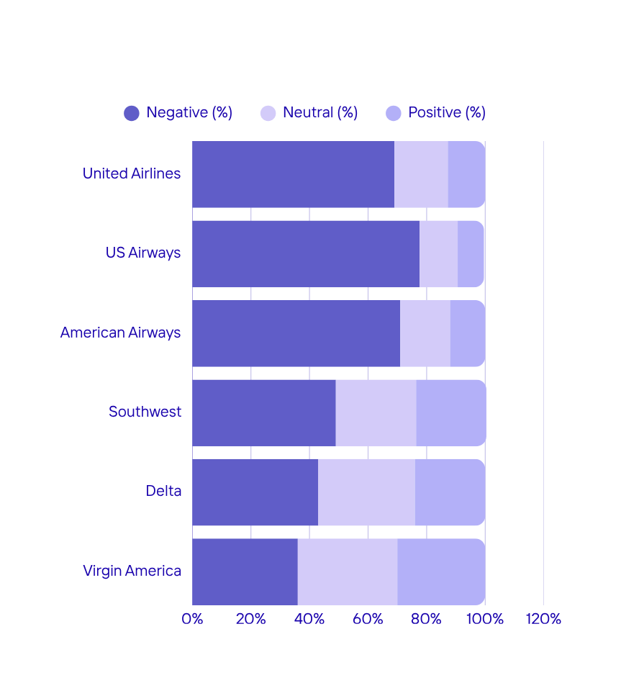
Sentiment by Airline
Comparison
Customer satisfaction varies across airlines:
→ United Airlines and US Airways show the highest concentration of negative sentiment, suggesting they face more service-related issues.
→ Southwest and Delta have moderate negativity, while Virgin America stands out with the most balanced sentiment, suggesting better customer satisfaction
05
twitter.com/airlineanalysis

Slide 6

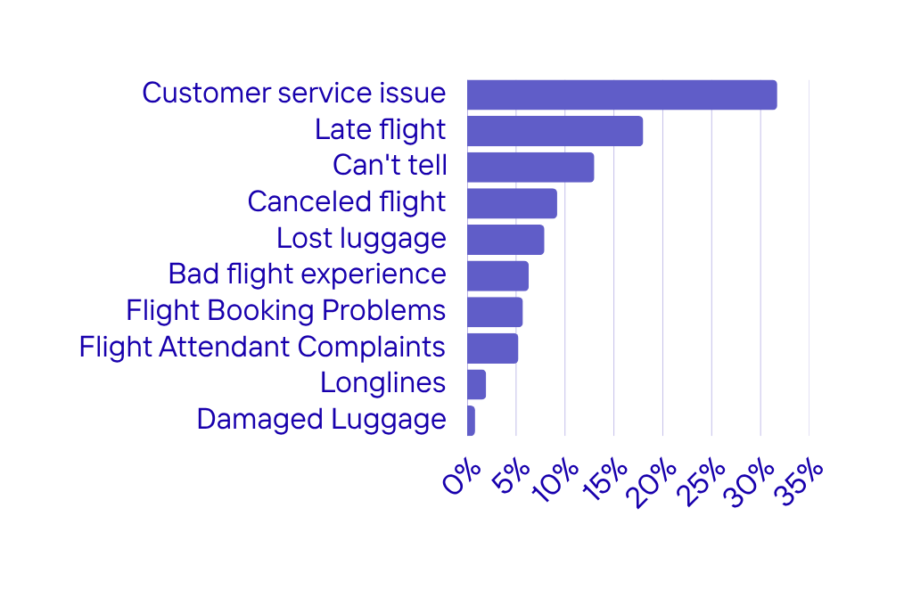
Top Reasons for
Negative Sentiment
Negative sentiment is mainly driven by customer service issues (31.7%), followed by flight delays and cancellations. These results show that improving communication and service quality is just as important as operational performance for reducing customer dissatisfaction.
06

Slide 7
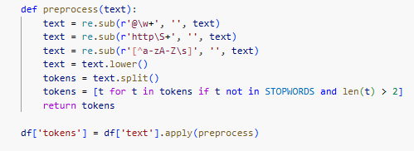
Text Preprocessing
Step 1: Remove @mentions and URLs
Step 2: Convert to Lowercase
Step 3: Tokenization
Step 4: Remove Stopwords
Clean raw tweet text by stripping user handles and web links that add noise to analysis.
Standardize all text to lowercase to ensure consistent word matching and reduce vocabulary size.
Split text into individual words (tokens) to enable word-level analysis and counting.
Filter out common words like "the", "is", "and" to focus on meaningful sentiment-bearing terms.
07

Slide 8
TF-IDF Configuration
TF-IDF Configuration
TF-IDF was used to convert tweets into numerical features by weighting words based on their importance in each tweet versus the whole dataset. it reduced noise by down-weighting repeated words, removing very rare words, and excluding overly common words. This produced a clean vocabulary of about 3,700 meaningful terms used as model inputs
08

Slide 9



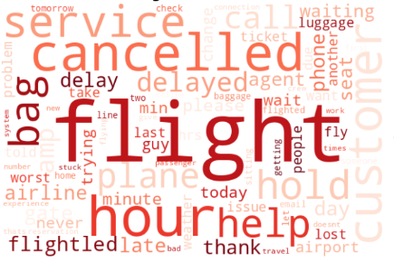
Word Clouds by Sentiment
Negative Sentiment
Dominant words reveal passenger frustrations:
• "delayed" - flight timing issues
• "cancelled" - disrupted travel plans
• "lost" - baggage problems
•"waiting" - poor service response
These terms appear frequently in complaint tweets.
09

Slide 10

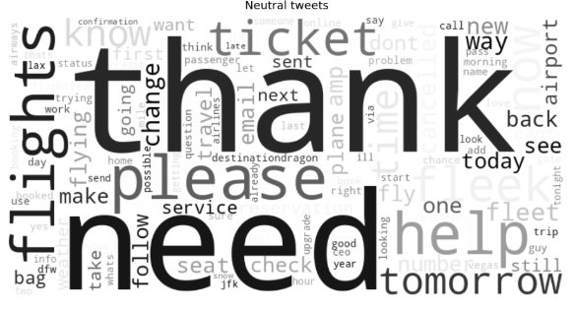
Word Clouds
by Sentiment
Neutral Sentiment
General airline-related vocabulary without strong emotion:
  "flights" - basic travel reference
  "thank" - expressions of appreciation
  "need" -general requests or inquiries
10

Slide 11

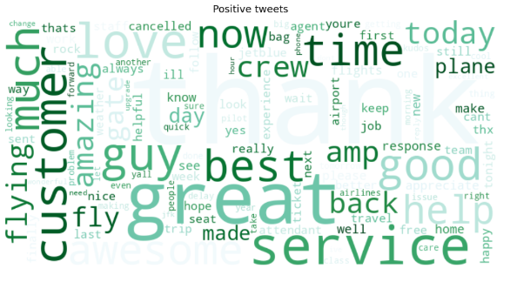
Word Clouds by Sentiment
Positive Sentiment
Appreciative language showing satisfaction:
• "great" - quality praise
• "amazing" - exceptional experiences
• "thank" - gratitude expressions
• "love" - strong positive emotion
Reflects memorable positive experiences.
11

Slide 12
Methods Overview
SUPERVISED LEARNING
UNSUPERVISED LEARNING
Model: Logistic Regression
Features: TF-IDF (3,700 terms)
Class imbalance handled via balanced class weighting
Evaluated with: Accuracy, Balanced Accuracy, Macro F1, Per-class F1
Requires labeled data: YES
Model: K-Means Clustering
Dim. Reduction: PCA → 50 components
Optimal K selected via Elbow Method (WCSS)
Evaluated with: Silhouette Score, Cluster Purity
Requires labeled data: NO
12

Slide 13

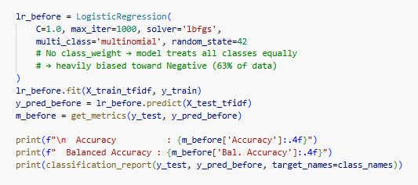
Model: Logistic Regression
→ Logistic Regression was applied on the labeled tweet dataset using TF-IDF features.
→ In this setup, each tweet was transformed into a numerical representation based on the importance of its words within the dataset.
→ The model was trained directly on this representation, using the original class distribution without any adjustment.
.
13

Slide 14

  Class Imbalance
The Skew
The dataset shows a strong sentiment imbalance, with 62.7% of tweets labeled as Negative.
This overrepresentation of complaints introduces a majority class bias, which reduced the model performance and weakened the learning of minority classes.
14

Slide 15
  The Fix
The Approach
To correct the imbalance in our dataset, we apply class_weight='balanced' during model training.
This technique ensures each class receives a weight inversely proportional to its frequency in the dataset, allowing the model to focus more on minority classes while still considering majority classes effectively for better prediction accuracy.
The Weights
  The weights assigned to each class in this model are as follows:
  Negative class is downweighted to 0.529 to reduce dominance in training
  Neutral class is upweighted to 1.574 to improve learning of minority patterns
  Positive class is upweighted to 2.067 to further strengthen its representation
This balance helps the model learn all three sentiments fairly, addressing the class distribution issue.
15

Slide 16

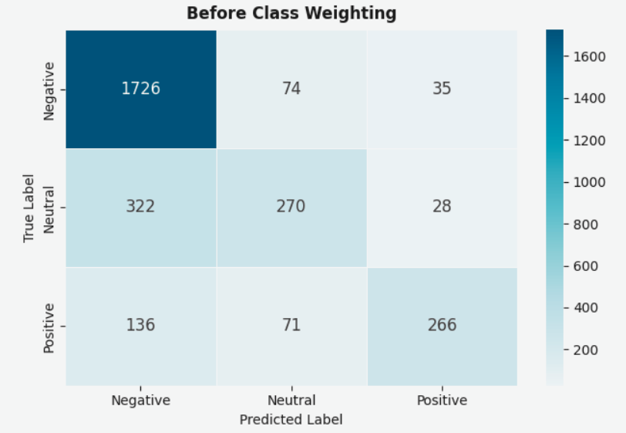
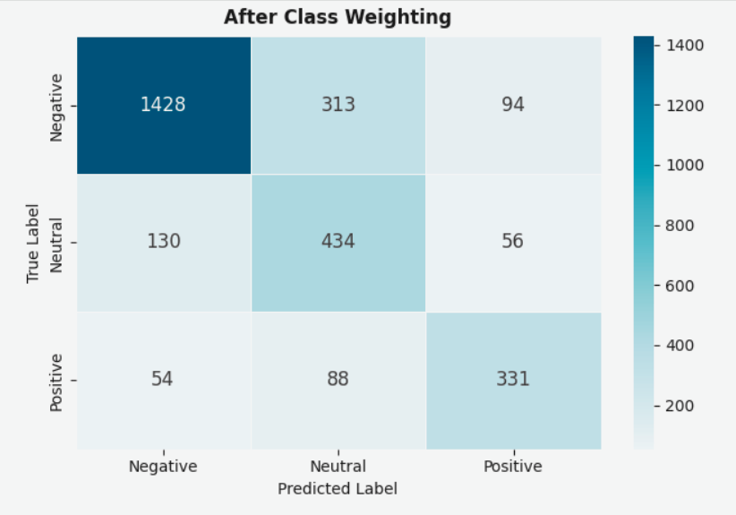
confusion matrices
  Neutral misclassification reduced from 322 to 130
  Positive misclassification reduced from 136 to 54
  Better recognition of all three sentiment classes
  Reduced bias toward the Negative class
  Overall increase in sentiment classification accuracy
  Strong bias toward the majority class (Negative)
  Frequent misclassification of Neutral tweets as Negative (322 cases)
  Significant misclassification of Positive tweets as Negative (136 cases)
  Poor discrimination between sentiment classes
16

Slide 17

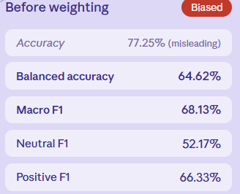
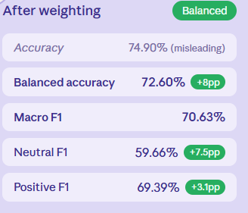
Results & Performance
after weighting
17
On imbalanced data: balanced accuracy and macro F1 are the only metrics that tell the truth.

Slide 18
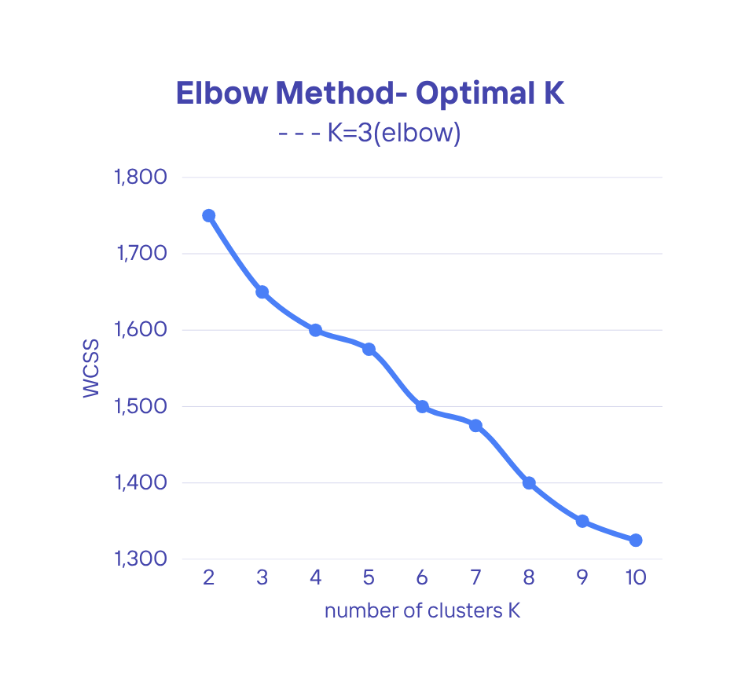
PCA + K-means
Dimensionality Reduction via PCA
→Principal Component Analysis (PCA) was used to reduce the high-dimensional TF-IDF space into a smaller set of 50 principal components, preserving the most important information while removing noise.
→This makes the data more suitable for efficient clustering and helps K-Means perform better in a lower-dimensional space.
Finding K:
→ To select the optimal number of clusters, the Elbow Method was used by plotting WCSS against different values of K. The elbow point at K = 3 indicates the best balance, matching the three sentiment classes and improving clustering interpretability.
18

Slide 19
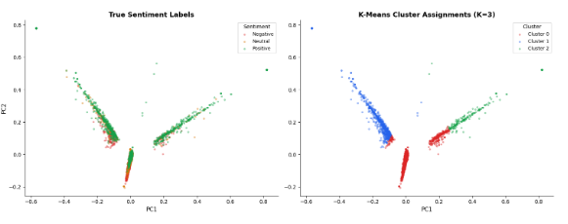
K-Means Results
Evaluation Metrics:
K-Means clustering achieved a Cluster Purity of 66.5%, indicating that most tweets were grouped into the correct sentiment clusters.
A Silhouette Score of 0.218 suggests a moderate but meaningful cluster structure, enabling insights without labeled data.
Cluster Profiles:
Cluster 0: Mostly Negative sentiment, with keywords like “cancelled” and “delayed”.
Cluster 1: Mixed Negative and Neutral sentiment, containing more ambiguous language.
Cluster 2: Predominantly Positive sentiment, featuring words like “thank”, “great”, and “love”.
19

Slide 20
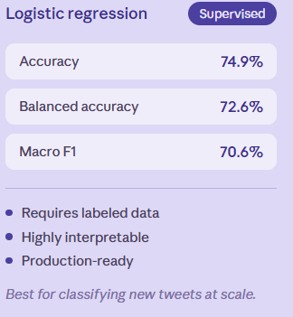
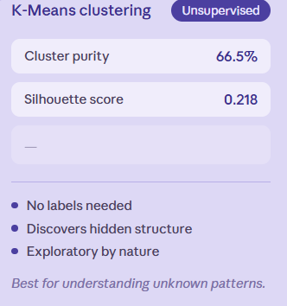
Supervised VS Unsupervised
20

Slide 21

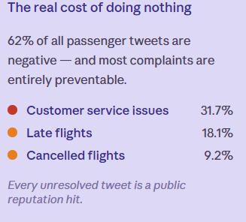
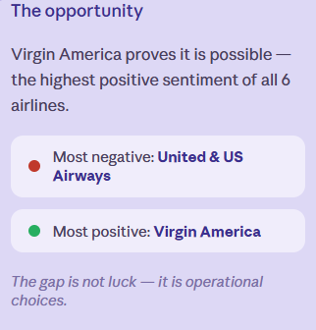
Business Insights &
Conclusion
21

Slide 22



Thank
You!

